Slide 1
Credit Card Classification: Prediction of Default Payments
Nadia Oktiarsy, FSDS Batch-016 RMT

Slide 2
A default usually happens after six months in a row of not making at least the minimum payment due.
Objectives
No Default
More consistency to loan process
Classification Model
Credit Card Holders Data
Default
Telltale signs of a potential defaulter

Slide 3
The distribution of Default Payment is highly imbalanced. Non-defaults is outnumbering defaults almost four times
Disadvantages
It can discard useful information about the data itself which could be necessary for building rule-based classifiers.

Slide 4
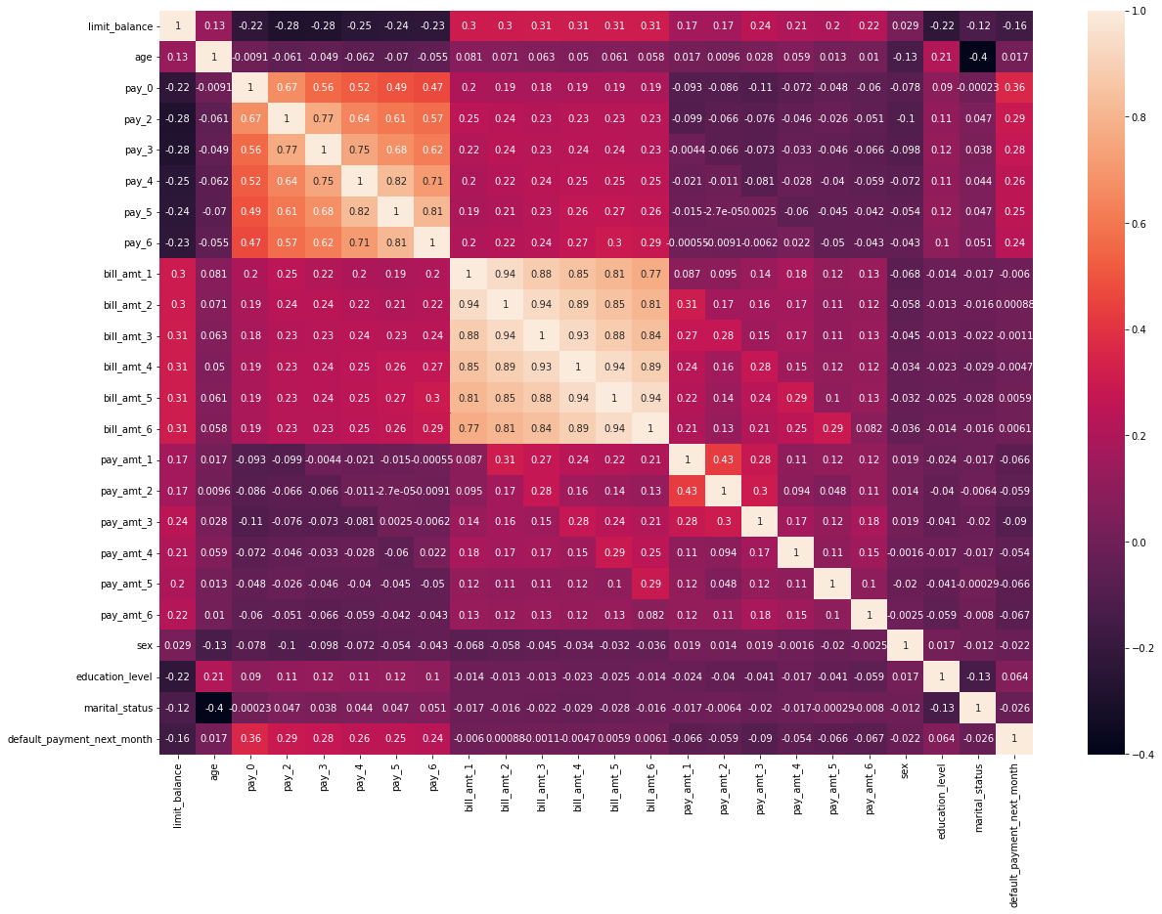
Feature Selection: The correlation between target and features are either weak correlation or no correlation. There is one feature with a weak significance.
Chi-square
Sex | 0.23
Marital Status | 0.195
Education Level | 0.02
Choosing features intuitively as an art
Some impossible features can not be removed because of its importance information for banking regardless the statistical result:
pay, bill_amt, and pay_amt
Dropped features: Education Level

Slide 5
Top 2 Ensemble Learning techniques with the highest score:
Random Forest and Adaptive Boost Classifier
Cross-validation (k=5), Default Parameters, score: Accuracy
Algorithms | Mean | Standard Deviation
Logistic regression | 0.82 | 0.01
SVM | 0.81 | 0.015
Decision Tree | 0.74 | 0.019
Random Forest | 0.82 | 0.21
KNN | 0.79 | 0.015
Gaussian Naïve Bayes | 0.32 | 0.03
AdaBoostClassifier | 0.83 | 0.02
Key Takeaways for Ensemble Learning
Random Forest Classifier is a bagging technique that aims to decrease variance, but not bias.
Adaptive Boost Classifier (AdaBoost) is a boosting technique that aims to decrease bias, but not variance.
The chosen algorithm: Adaptive Boost Classifier

Slide 6
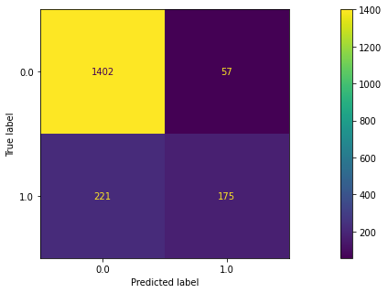
Default Parameters results: overfitting and inaccurate. Hyperparameter Tuning is needed for the next step.
Confusion Matrix (Train Set)
Classification Report (Train)
F1-Score | 0.557325
Precision | 0.754310
Recall | 0.441919
Accuracy | 0.850135
Recall class-1 result is lower than 50% in classification scores, which means the model is not able to detect the class well enough although the precision is high.
Notes:
Based on the confusion matrix and Classification Score, we can see that False positive is 225 and True Negative is 171:
False Positive (class 0 predicted, 1 true) is higher than True Negative (class 1 predicted, 1 true)
This creates recall class-1 result is lower than 50% in classification scores, which means the model is not able to detect the class well enough although the precision is high.

Slide 7
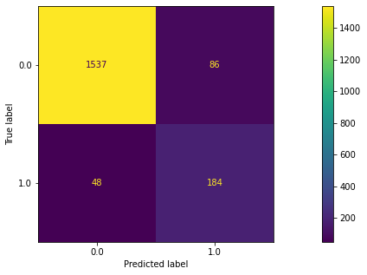
Combining the predictions from many weak learners, in this case for example, is Decision Tree Classifier to get boosted by AdaBoost.
Avg. Processing time: 64 minutes
The best hyperparameter:
'base_estimator__max_depth': 3,
'base_estimator__min_samples_leaf': 5,
'base_estimator__criterion’: ’gini’,
'algorithm’ : 'SAMME',
'learning_rate': 0.97,
'n_estimators': 25
Confusion Matrix (Train Set)
Classification Report (Train)
F1-Score | 0.624625
Precision | 0.770370
Recall | 0.525253
Accuracy | 0.865229

Slide 8
Conclusions: It is predicted true based on train and test set that number of non-default payment is higher than default payment
Classification Report (Train)
Key Takeaways:
 | Baseline | Grid Search
F1-Score | 0.557325 | 0.624625
Precision | 0.754310 | 0.770370
Recall | 0.441919 | 0.525253
Accuracy | 0.850135 | 0.865229
The classes are working to model.
The overfitting happens in test set because of the difference of number of data.
Some features and target need to be checked its balance. The imbalance data will create a misinformation, and the worst is that the prediction will be biased or error when it is not handled correctly.
Classification Report (Test)
 | Baseline | Grid Search
F1-Score | 0.454183 | 0.776632
Precision | 0.721519 | 0.949580
Recall | 0.331395 | 0.656977
Accuracy | 0.828321 | 0.918546

Slide 9
Thank you
Notes:
Target’s balance should be handled firstly. It is important, not only for features to be cleansed.
Undersampling and oversampling
Dataset should be balanced, handle it firstly
Model improvement: threshold

